Slide 1
The Families First Coronavirus Response Act (FFCRA)

Slide 2
Agenda
I. Overview of FFCRA
II. How to Request & Record Leave
IV. Case Studies
V. Resources
VI. Question & Answer

Slide 3
Overview of FFCRA

Slide 4
Overview of FFCRA
The Families First Coronavirus Response Act (FFCRA or Act)
provide employees with
1) paid sick leave - (emergency paid sick leave or EPSL)
2) emergency family and medical leave (FMLA) for specified reasons related to COVID-19.
These provisions will apply from April 1, 2020 through December 2020.
At Travis County they apply from March 22, 2020 through December 2020.

Slide 5
Overview of FFCRA
PAID LEAVE ENTITLEMENTS
Up to two weeks (80 hours, or a part-time employee's two-week equivalent) of paid sick leave
A part-time employee - number of hours normally scheduled to work over two-week period
Pay is at 100% of wage rate

Slide 6
Overview of FFCRA
WHO IS ELIGIBLE
All employees (Regular, temporary, etc.)
Available first day of employment

Slide 7
Overview of FFCRA
WHAT REASONS QUALIFY FOR THE LEAVE
An employee is entitled to take leave related to COVID-19 if the employee is unable to work, including unable to telework, because the employee:
is subject to a Federal, State, or local quarantine or isolation order related to COVID-19;
2) has been advised by a health care provider to self-quarantine related to COVID-19;
3) is experiencing COVID-19 symptoms and is seeking a medical diagnosis;…
(NOTE: ---- #1 - #3 RELATE TO THE EMPLOYEE DIRECTLY)

Slide 8
Overview of FFCRA
WHAT REASONS QUALIFY FOR THE LEAVE
An employee is entitled to take leave related to COVID-19 if the employee is unable to work, including unable to telework, because the employee:
(NOTE: ---- #4 - #5 RELATE TO THE OTHERS)
4) is caring for an individual subject to an order described in (1) or self-quarantine as described in (2);
5) is caring for his or her child whose school or place of care is closed (or child care provider is unavailable) due to COVID-19 related reasons; or
6) is experiencing any other substantially-similar condition specified by the U.S. Department of Health and Human Services.

Slide 9
Overview of FFCRA
WHAT REASONS QUALIFY FOR THE EMERGENCY
FAMILY AND MEDICAL LEAVE (FMLA)
Employees employed for at least 30 days prior to their leave request may be eligible for up to an additional 10 weeks expanded family and medical leave (FMLA) for reason #5 below:
5) is caring for his or her child whose school or place of care is closed (or child care provider is unavailable) due to COVID-19 related reasons
Paid at 100% of wage rate.
Takes into account any previous FMLA awarded in the previous 12 months for a maximum of 12 weeks.

Slide 10
How to Request & Record Leave

Slide 11
Request & Record the Leave
1. Employee completes Notice of Need for Families First Coronavirus Response Act (FFCRA) Leave
Found under Forms – HRMD Forms – Leave Forms section
2. Employee provides documentation to support request
3. Manager/HR Liaison reviews information and determines if information supports eligibility.
4. Employee is notified that leave requirements are met.
5. Employee enters appropriate timesheet code to match the leave.
NOTE: EMPLOYEES WHO HAVE USED FMLA WITHIN THE LAST 12 MONTHS WILL NEED TO CONTACT
THEIR FMLA ADMINISTRATOR IF REQUESTING THE EMERGENCY FMLA (FOR SCHOOL/CHILDCARE CLOSING)

Slide 12
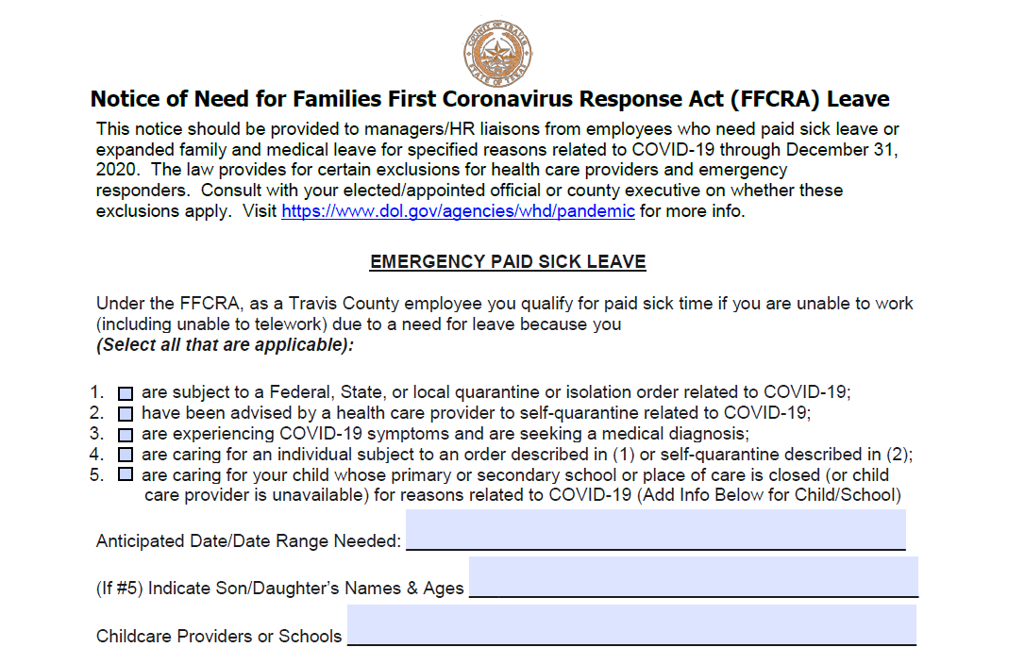
1) Use Form for Leave (found under HRMD Forms)

Slide 13
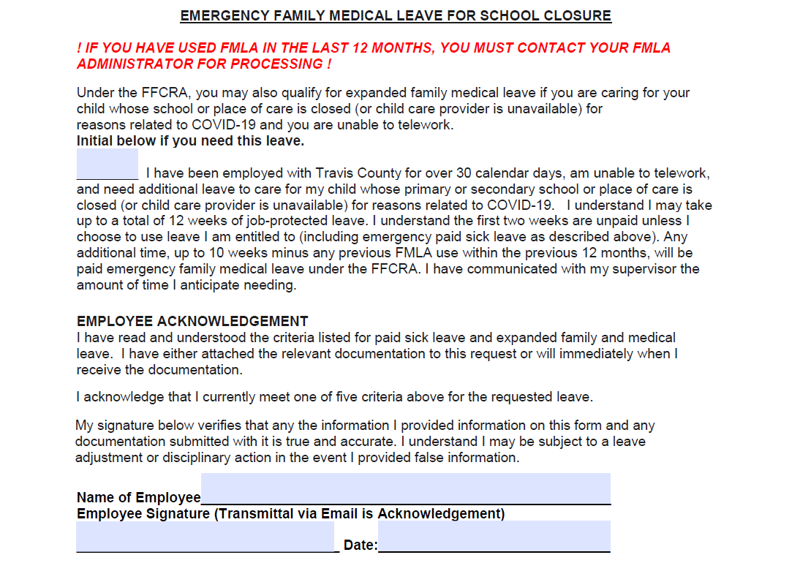

Slide 14
Request & Record the Leave
ACCEPTABLE DOCUMENTATION
#1 - subject to a quarantine or isolation order
- the name of the government entity that issued the order;
#2 - if the employee has been advised to self-quarantine due to COVID-19 concerns
- the name of the health care provider who advised the employee;
#4 - if the employee is caring for someone else
- the employee must provide the name of the government entity that issued the quarantine or isolation order affecting the individual, or the
- information of the health care provider who advised the individual to self-quarantine; or
#5 - if the employee is taking care of a child whose school is closed or child care is unavailable due to COVID-19, - -the employee must provide the name of the child being cared for, the name of the school, place of care or child care provider that has closed, and a representation that no other suitable person will be caring for the child during the leave
* You may not require more documentation than this.

Slide 15
Request & Record the Leave
RECORDING THE LEAVE
- Intermittent Leave is ONLY available for
- Employee is working on site AND needs leave for school closing/childcare OR
- Employees who are teleworking for all reasons
The department/office must agree to intermittent leave, otherwise, has to be used continuously.

Slide 16
Request & Record the Leave
TIMESHEET CODES
For leave taken from March 22 – March 31:
1140 Administrative Leave paid combined with Emergency Event ID 300320-AL if the leave was used for any of the 6 qualifying reasons.
For leave taken from April 1 forward:
2021 COVID-19 Employee Sick Pd combined with Emergency Event ID 300320-EPS if the leave is for you for #1, #2, and #3 qualifying reason.
2022 COVID-19 Family Sick-Pd combined with Emergency Event ID 300320-EPS if the leave was used to care for others or due to school/closing reason.
FMLA Administrator will have emergency FMLA codes available.

Slide 17
CASE STUDIES

Slide 18
Case #1 Jimmy is a temp employee who works 40 hours a week. Work has slowed down to 30 hours a week and he’d like to use the emergency paid sick leave to supplement hours. Can he use?

Slide 20
Case #1 Jimmy is a temp employee who works 40 hours a week. Work has slowed down to 30 hours a week and he’d like to use the emergency paid sick leave to supplement hours. Can he use? No. He does not meet any of the qualifying reasons.

Slide 21
Case #2 Sue participated in a tele-medicine visit with the employee health clinic and was issued documentation by Dr. Brown to self quarantine. Can she use employee paid sick leave?

Slide 23
Case #2 Sue participated in a tele-medicine visit with the employee health clinic and was issued by Dr. Brown to self quarantine. Can she use employee paid sick leave? YES. Sue meets one of the qualifying reasons

Slide 24
Case #3 Sue would like to extend her employee paid sick leave to be emergency FMLA. Can she be paid up to the additional 10 weeks of leave?

Slide 26
Case #3 Sue would like to extend her employee paid sick leave to be emergency FMLA. Can she be paid up to the additional 10 weeks of leave? NO. This is offered for school/childcare closings only.

Slide 27
Case #4 Todd used 8 weeks of FMLA for recovery from surgery. His 7 year-old boy is at home due to school closings and Todd can not work or telework due to needing leave. Does Todd qualify for leave, and if so, how much?

Slide 30
Case #4 Todd used 8 weeks of FMLA for recovery from surgery. His 7 year-old boy is at home due to school closings and Todd can not work or telework due to needing leave. Does Todd qualify for leave, and if so, how much? YES. Todd can get 4 weeks of FMLA coverage. He can get 2 weeks paid with EPSL or his own leave + 2 weeks Emergency FMLA paid.

Slide 31
RESOURCES

Slide 32
Resources *can be found in Liaison Resources & News
Department of Labor Poster https://www.dol.gov/sites/dolgov/files/WHD/posters/FFCRA_Poster_WH1422_Non-Federal.pdf
*Travis County FFCRA Poster
http://traviscentral/files/hr/docs/ffcra-paid-leave.pdf
*Employee Frequently Asked Questions related to FFCRA
http://traviscentral/files/hr/docs/FinalFFCRAFAQs.pdf
*Notice of Need for FFCRA Leave
http://traviscentral/files/hr/docs/04032020NoticeofNeedforFFCRALeave.pdf
*Video on Timesheet Entry
https://rise.articulate.com/share/wp9kfQU3b9dw1QRkpLjRpYNMQfjnGCFP#/

Slide 33
Questions

