Slide 1
The Families First Coronavirus Response Act (FFCRA) – Part II
April 13, 2020

Slide 2
Agenda
I. Quick Overview of FFCRA
II. Reminder on Request & Record Leave
III. Things to Keep in Mind
IV. Recently Received Questions & Answers
V. Resources

Slide 3
Quick Overview of FFCRA

Slide 4
Overview of FFCRA
The Families First Coronavirus Response Act (FFCRA or Act)
provide employees with
1) paid sick leave - (emergency paid sick leave or EPSL)
2) emergency family and medical leave (FMLA) for specified reasons related to COVID-19.
These provisions will apply from April 1, 2020 through December 2020.
At Travis County they apply from March 22, 2020 through December 2020.

Slide 5
Overview of FFCRA
PAID LEAVE ENTITLEMENTS
Up to two weeks (80 hours, or a part-time employee's two-week equivalent) of paid sick leave
A part-time employee - number of hours normally scheduled to work over two-week period
Pay is at 100% of wage rate

Slide 6
Overview of FFCRA
WHO IS ELIGIBLE
All employees (Regular, temporary, etc.)
Available first day of employment
NOTE: Employees are eligible on first day of employment for emergency paid sick leave, but eligible after 30 days for Emergency FMLA

Slide 7
Overview of FFCRA
WHAT REASONS QUALIFY FOR THE LEAVE
An employee is entitled to take leave related to COVID-19 if the employee is unable to work, including unable to telework, because the employee:
is subject to a Federal, State, or local quarantine or isolation order related to COVID-19;
2) has been advised by a health care provider to self-quarantine related to COVID-19;
3) is experiencing COVID-19 symptoms and is seeking a medical diagnosis;…
(NOTE: ---- #1 - #3 RELATE TO THE EMPLOYEE DIRECTLY)

Slide 8
Overview of FFCRA
WHAT REASONS QUALIFY FOR THE LEAVE
An employee is entitled to take leave related to COVID-19 if the employee is unable to work, including unable to telework, because the employee:
(NOTE: ---- #4 - #5 RELATE TO THE OTHERS)
4) is caring for an individual subject to an order described in (1) or self-quarantine as described in (2);
5) is caring for his or her child whose school or place of care is closed (or child care provider is unavailable) due to COVID-19 related reasons; or
6) is experiencing any other substantially-similar condition specified by the U.S. Department of Health and Human Services.

Slide 9
Overview of FFCRA
WHAT REASONS QUALIFY FOR THE EMERGENCY
FAMILY AND MEDICAL LEAVE (FMLA)
Employees employed for at least 30 days prior to their leave request may be eligible for up to an additional 10 weeks expanded family and medical leave (FMLA) for reason #5 below:
5) is caring for his or her child whose school or place of care is closed (or child care provider is unavailable) due to COVID-19 related reasons
Paid at 100% of wage rate.
Takes into account any previous FMLA awarded in the previous 12 months for a maximum of 12 weeks.

Slide 10
How to Request & Record Leave

Slide 11
Request & Record the Leave
1. Employee provides oral notice or completes Notice of Need for Families First Coronavirus Response Act (FFCRA) Leave (form is provided for convenience)
Found under Forms – HRMD Forms – Leave Forms section
2. Employee provides documentation to support request
3. Manager/HR Liaison reviews information and determines if information supports eligibility.
4. Employee is notified that leave requirements are met.
5. Employee enters appropriate timesheet code to match the leave.
NOTE: EMPLOYEES WHO HAVE USED FMLA WITHIN THE LAST 12 MONTHS WILL NEED TO CONTACT
THEIR FMLA ADMINISTRATOR IF REQUESTING THE EMERGENCY FMLA (FOR SCHOOL/CHILDCARE CLOSING)

Slide 12
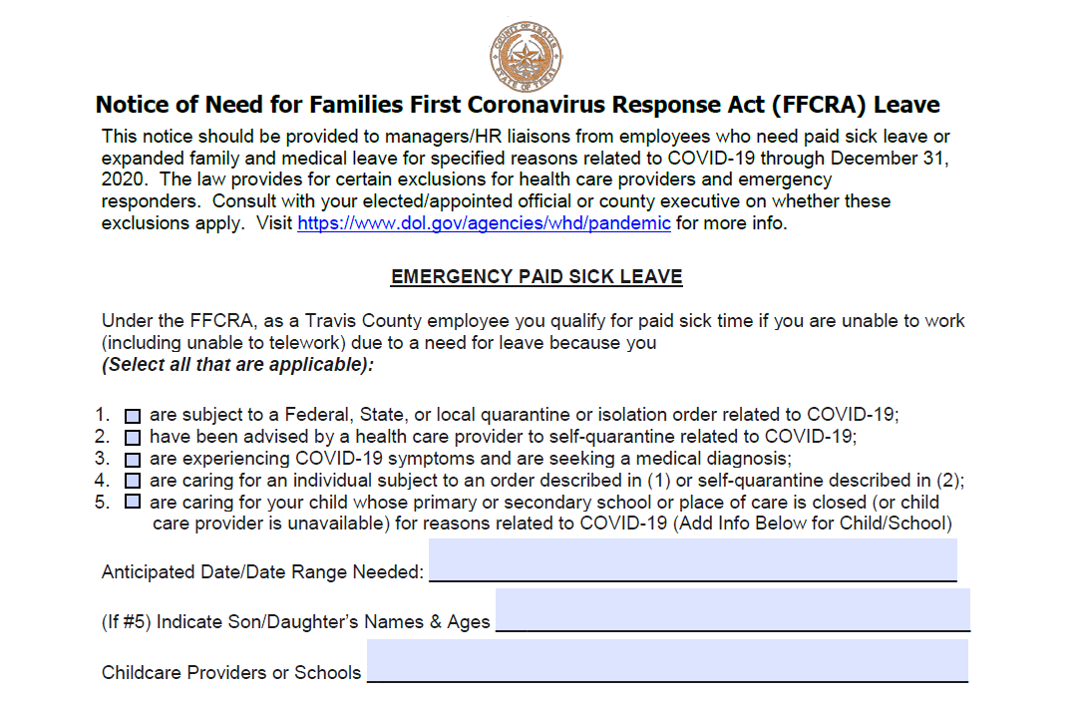
1) Use Form for Leave (found under HRMD Forms)

Slide 13
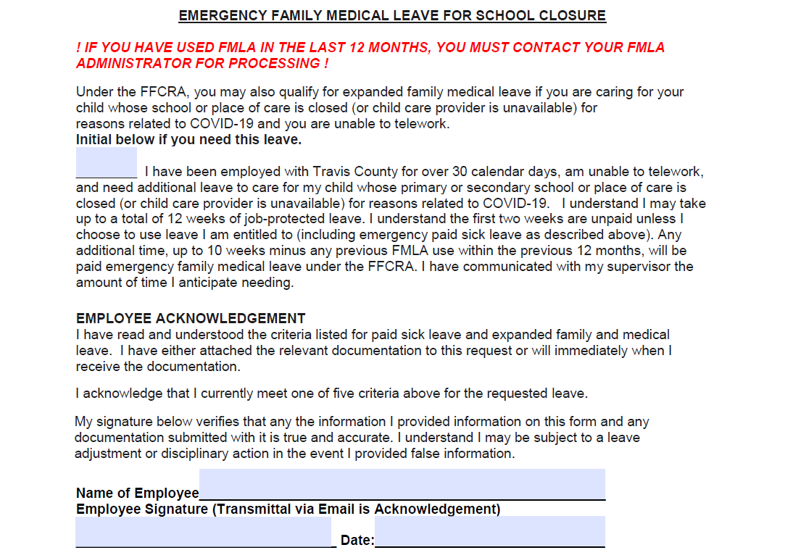

Slide 14
Request & Record the Leave
ACCEPTABLE DOCUMENTATION
#1 - subject to a quarantine or isolation order
- the name of the government entity that issued the order;
#2 - if the employee has been advised to self-quarantine due to COVID-19 concerns
- the name of the health care provider who advised the employee;
#4 - if the employee is caring for someone else
- the employee must provide the name of the government entity that issued the quarantine or isolation order affecting the individual, or the
- information of the health care provider who advised the individual to self-quarantine; or
#5 - if the employee is taking care of a child whose school is closed or child care is unavailable due to COVID-19, - -the employee must provide the name of the child being cared for, the name of the school, place of care or child care provider that has closed, and a representation that no other suitable person will be caring for the child during the leave
* You may not require more documentation than this.

Slide 15
Request & Record the Leave
RECORDING THE LEAVE
- Intermittent Leave is ONLY available for
- Employee is working on site AND needs leave for school closing/childcare OR
- Employees who are teleworking for all reasons
The department/office must agree to intermittent leave, otherwise, has to be used continuously.

Slide 16
Request & Record the Leave
TIMESHEET CODES
For leave taken from March 22 – March 31:
1140 Administrative Leave paid combined with Emergency Event ID 300320-AL if the leave was used for any of the 6 qualifying reasons.
For leave taken from April 1 forward:
2021 COVID-19 Employee Sick Pd combined with Emergency Event ID 300320-EPS if the leave is for you for #1, #2, and #3 qualifying reason.
2022 COVID-19 Family Sick-Pd combined with Emergency Event ID 300320-EPS if the leave was used to care for others or due to school/closing reason.
FMLA Administrator will have emergency FMLA codes available.

Slide 17
Things to Keep in Mind

Slide 18
Things to Keep in Mind
Here are a additional helpful tidbits/clarifications:
- “Individual” means an Employee's immediate family member, a person who regularly resides in the Employee's home, or a similar person with whom the Employee has a relationship that creates an expectation that the Employee would care for the person if he or she were quarantined or self-quarantined. For this purpose, “individual” does not include persons with whom the Employee has no personal relationship.

Slide 19
Things to Keep in Mind
Here are additional helpful tidbits/clarifications:
- Leave notice may be oral; the Notice for FCCRA Leave is as needed.
- This leave is not as formal as FMLA. Quick assessment is okay.
- Documentation is noted on the FAQs. Nothing beyond that is allowed.
- Discuss before denying leave. If an employee fails to give proper notice, let the employee know then provide an opportunity to provide the required documentation prior to denying the request for leave.

Slide 20
Recent Q&A

Slide 21
Question #1 If it is necessary for me to care for my child because his or her school or place of care is closed, or child care provider is unavailable, do I get paid sick leave, expanded family and medical leave, or both—how do they interact?

Slide 22
Answer #1 If it is necessary for me to care for my child because his or her school or place of care is closed, or child care provider is unavailable, do I get paid sick leave, expanded family and medical leave, or both—how do they interact? You may be eligible for both types of leave, but only for a total of twelve weeks of paid leave. You may take both paid sick leave and expanded family and medical leave if is necessary for you to care for your child whose school or place of care is closed, or child care provider is unavailable, due to COVID-19 related reasons. The Emergency Paid Sick Leave Act provides for an initial two weeks of paid leave. This period thus covers the first ten workdays of expanded family and medical leave, which are otherwise unpaid under the Emergency and Family Medical Leave Expansion Act unless you elect to use existing vacation, personal, or medical or sick leave under your employer’s policy. After the first ten workdays have elapsed, you will receive 100% of your regular rate of pay for the hours you would have been scheduled to work in the subsequent ten weeks under the Emergency and Family Medical Leave Expansion Act. The additional ten weeks of emergency family and medical leave is only for care for your child whose school or place of care is closed, or child care provider is unavailable, due to COVID-19 related reasons.

Slide 23
Question #2 If I use all 12 weeks of the emergency family medical leave because it was necessary for me to care for my child due to school closings, can I get more FMLA if I am sick?

Slide 24
Answer #2 If I use all 12 weeks of the emergency family medical leave because it was necessary for me to care for my child due to school closings, can I get more FMLA if I am sick? Has FMLA been exhausted? If its within a rolling 12-month period and 480 hours have been used, then FMLA has been exhausted.

Slide 25
Question #3 I am an employee. I become ill with COVID-19 symptoms, decide to quarantine myself for two weeks, and then return to work. I do not seek a medical diagnosis or the advice of a health care provider. Can I get paid for those two weeks under the FFCRA?

Slide 26
Answer #3 I am an employee. I become ill with COVID-19 symptoms, decide to quarantine myself for two weeks, and then return to work. I do not seek a medical diagnosis or the advice of a health care provider. Can I get paid for those two weeks under the FFCRA? Generally no. If you become ill with COVID-19 symptoms, you may take paid sick leave under the FFCRA only to seek a medical diagnosis or if a health care provider otherwise advises you to self-quarantine. If you test positive for the virus associated with COVID-19 or are advised by a health care provider to self-quarantine, you may continue to take emergency paid sick leave. Deciding to self quarantine without medical advice, even if you have COVID-19 symptoms would not qualify.

Slide 27
Question #4 I would like to keep my grandchild who is unable to go to school due to school closing? Am I eligible for the Emergency Family Medical Leave?

Slide 28
Answer #4 I would like to keep my grandchild who is unable to go to school due to school closing? Am I eligible for the Emergency Family Medical Leave? Emergency Family Medical Leave is available for son or daughter (to included foster and adopted kids), but nieces/nephews/godchildren/grandchild are not included unless the person has legal guardianship of them.

Slide 29
Other Questions

Slide 30
RESOURCES

Slide 31
Resources *can be found in Liaison Resources & News
Department of Labor Poster https://www.dol.gov/sites/dolgov/files/WHD/posters/FFCRA_Poster_WH1422_Non-Federal.pdf
*Travis County FFCRA Poster
http://traviscentral/files/hr/docs/ffcra-paid-leave.pdf
*Employee Frequently Asked Questions related to FFCRA
http://traviscentral/files/hr/docs/FinalFFCRAFAQs.pdf
*Notice of Need for FFCRA Leave
http://traviscentral/files/hr/docs/04032020NoticeofNeedforFFCRALeave.pdf
*Video on Timesheet Entry
https://rise.articulate.com/share/wp9kfQU3b9dw1QRkpLjRpYNMQfjnGCFP#/

