Slide 1
Human Resources Liaison Meeting – January 2020
Human Resources Management Department Friday, January 24, 2020

Slide 2
HR Liaison Meeting Agenda
Director’s Update
Risk Management
Clinic Reminders
Compensation
HR Services
HHS Summer Youth
Talent Services
Benefits

Slide 4
Bilingual Testing
When
Starting February 1, 2020
Who
Eligible POPS Employees
How much
Via individual Cell Phone or Computer
Where
How often
$105.00 paid by the Employee (reimbursement of the test cost is up to the department)
Monday through Friday between 9am and 6pm CST
Identification (driver’s license) shown to Berlitz for testing

Slide 5
Bilingual Testing continued
How it works (confirming the process still):
HR Liaison to email Berlitz directly (email address given 2/1/2020):
Name of Examinee
Language to tested (Spanish or Vietnamese)
Date/date range or time/time range for test delivery
Time Zone: CST
Tests can be scheduled Monday through Friday between 9am and 6pm CST
Once test is confirmed:
Berlitz should be notified of cancellation or reschedule by 5pm CST the business day prior to the confirmed test date,
Otherwise considered a “NO SHOW” and;
The examinee is still responsible for the cost
Test results will be emailed to HRMD Admin within 3 business days of delivery date
HRMD Admin will forward to the department HR Liaison(s) of which the Employee belongs

Slide 6
Risk Management
York Risk Services Group
DWC Form Reporting from an Employer’s Perspective

Slide 7
Timely Filing of DWC Forms
•DWC – 1 (Employers First Report of Injury)
•DWC – 2 (Employers Reimbursement of Voluntary Payment)
•DWC – 3 (Employers Wage Statement)
•DWC – 6 (Employers Supplemental Report of Injury)

Slide 8
Section 415 Texas Labor Code
Penalties and Fines for Violations
•The administrative penalty shall not exceed $25,000 per day, per occurrence. Each day of non-compliance constitutes a separate violation. Most of these violations include failure to timely file forms, payment of benefits or responding to DWC or TDI orders.
•Fines relate to certain “insurance” requirements and could result in $1,000 for each act or violation not to exceed $10,000 in the aggregate.
•Class A misdemeanor is reserved for those infractions involving false statements, concealing or destroying documents and could result in a Class A misdemeanor.

Slide 9
DWC 1- First Report of Injury
File a DWC-1, First Report of Injury is due to York within 8 days of the date:
Of a work-related injury that cause an employee to miss more than 1 day of work, OR
Of a work-related fatality, OR
The employer learns a employee has an occupational illness even if employee hasn’t missed work
Failure to timely report could result in an administrative violation

Slide 10
DWC 2 – Reimbursement of Voluntary Payment
To provide information to York and TDI that the employee is receiving salary continuation from the County
The request must be filed within 7 days after the initial payment of compensation (or medical benefits).
The reimbursement is to be made within 7 days after notice. Since the County is self-insured this does not apply
Failure to timely report could result in an administrative violation

Slide 11
DWC 3 – Wage Statement
To provide the employee’s wage information to York for calculating the employee’s Average Weekly Wage (AWW) to establish benefits due to the employee.
The average wage the employee earned during the 13 weeks immediately preceding the date of injury
The wage statement must be filed within 30 days of the employees’ eighth day of disability.
Failure to timely report could result in an administrative violation

Slide 12
DWC 6 – Supplemental Report of Injury
Requires the Employer to report all Return to Work and Post-Injury Change of Earnings and is due:
three (3) days from the date an injured worker returns to work; and
three (3) days from the date an injury causes an employee to miss additional work after returning to work.
ten (10) days from the end of a pay period in which an injured worker's pay changes; and
ten (10) days from the date an injured worker resigns or is terminated;
Failure to timely report could result in an administrative violation

Slide 13
Frequently Asked Questions - #1
Do I need to notify York via a DWC-6 Form if an employee is NOT losing time from work, but has to attend a doctor’s appointment or physical therapy?
It is in the best interest to allow employees to attend their doctor’s appointment or physical therapy during the work day. Also, make sure to let the employee know they should try and minimize any time away from work. For example, utilize a lunch hour.
York does not request that you file a DWC-6 as “Disability” is defined as the inability, because of the compensable injury, to obtain and retain employment at wages equivalent to the pre-injury wage. (Section 401.011 Texas Labor Code)
“Treatment” is not “Disability”.

Slide 14
Frequently Asked Questions - #2
When is a workplace incident that causes injury to one of my employees not payable under workers' compensation?
The County is not liable for benefits if:
your employee was injured while in a state of intoxication;
the injury was caused by the employee's willful attempt to injure himself or unlawfully injure another person;
your employee was injured while participating in a voluntary off-duty recreation, social, or athletic activity that was not part of the employee's duties;
the injury arose out of an act of God; or
horseplay caused the injury.

Slide 15
Frequently Asked Questions - #3
Am I required to hold my employee's job open for them after they are injured?
York encourages a Modified Duty Program. However, you are not required under the Texas Workers' Compensation Act to provide employment after an injury occurs.
However, make sure to check your personnel policy regarding FMLA prior to terminating an employee and remember to be consistent with your employees.
Consider implementing a Neutral Absence Policy.
It is permissible to terminate an employee who is out on workers' compensation, given business necessity or other reasons that fall within the County’s policy

Slide 16
Frequently Asked Questions - #4
As an employer, how long to I have keep a record of all work related injuries?
The records must be kept for at least five (5) years from the last day of the year in which the injury, illness or fatality occurred, or for the period of time required by the Texas State Library and Archives Commission retention schedule.

Slide 17
Frequently Asked Questions - #5
Can an injury occurring while walking be considered compensable? YES
Why??? Since everybody walks both at work and outside of work, why would this be considered a compensable injury?
If an employee who is walking suffers an injury while furthering the business of the employer and it arose out of employment, then it would be compensable.
Example:
If an employee’s knee popped causing an injury when he put his foot on the ground while walking down the hallway to go to a meeting at his place of employment, this would be compensable. The fact that the event could have occurred out side of work is not a defense. The employee was furthering the affairs of the employer by going to a meeting. The injury arose out of employment because the injury occurred when the employee put his foot down on the floor, which is owned or controlled by the employer. The floor is considered an instrumentality of the employer. This has been upheld through the Appeals Panel. If it can be shown that there was an underlying medical or degenerative condition, then there would be a defense in this type of claim. (I.e. prior knee surgery, arthritis in the knee)

Slide 18
QUESTIONS?

Slide 19
Clinic
Employee Health Clinic
Shawn Musarra

Slide 20
Updates & Useful Information
Interested in personalized health and nutrition strategies? Sign up to meet with our Health Coach, Mrs. Francis Diep. She has an office within the Main clinic and is mobile.
Frances Diep, RD, LD, CDE
Health Coach, Onsite Health Strategies
UnitedHealthcare
O: 512-854-5860
frances.diep@traviscountytx.gov d text

Slide 21
Clinic Locations, Days, & Hours of Operation
Mon-Thu 7:30 AM – 5:30 PM
Fridays 7:30 AM – 11:30 AM
Closed 12:00-1:00 PM for lunch
Main Clinic – (Open Monday-Friday) 700 Lavaca St., Suite 980
Airport Clinic – (Open Monday & Tuesday) 5501 Airport Blvd, Suite 201
Del Valle Clinic – (Open Wednesday- Friday) 3518 FM 973 South, Del Valle
For an appointment call: 512-854-5509
Don’t forget to bring your insurance card with you to each appointment for verification purposes.

Slide 22
Benefits Update

Slide 23
Benefit Staff Changes
Introduce New Benefit Staff
Sepeideh Oskoui – Benefits Administrator
Donnetta Kellogg – Benefits Specialist

Slide 24
Future Important Dates
Retirement Seminars
Date | Time | Location
Thursday, February 13, 2020 | 1 pm - 4 pm | Granger Bldg, 314 W 11th St, Room 115
Monday, March 9, 2020 | 9 am - 12 pm | 700 Lavaca St, Multi-Function Room B
Friday, April 17, 2020 | 9 am - 12 pm | TCSO Ruiz Bldg, 5555 Airport
Wednesday, May 13, 2020 | 9 am - 12 pm | 700 Lavaca St, Multi-Function Room B
Tuesday, June 23, 2020 | 1 pm - 4 pm | 700 Lavaca St, Multi-Function Room B

Slide 25
BREAK

Slide 26
Compensation

Slide 27
Compensation Topics
Upcoming Compensation Items
Processing Reminder

Slide 28
Upcoming Compensation Items Classified Employees
Changes to the Classified Pay Scale
Recommendations due to FLSA Threshold Change
Benchmark Study of FY 2020
Bilingual Pay

Slide 29
Upcoming Compensation Items POPS Employees
Revision of the POPS Scale
Market Analysis of Jobs on the POPS Scale

Slide 30
Processing Reminder
Reminder to always enter an employee’s legal name as it appears on the employee’s Social Security Card when doing a new hire or rehire
Issues with Identity Management team when Compensation Division is required to make post-hoc changes.

Slide 31
HR Services

Slide 32
Employee Recognition Day- Updates
Public Employee Recognition Week Proclamation- February 28, 2020
Employee Recognition Day- Tuesday, May 5, 2020
Honorees will receive an email invite
Employees 20+ years of service will be recognized
May 1st 2019- April 30, 2020

Slide 33
New Tuition Reimbursement Training:
For more information:
http://traviscentral/hr/at-work/tuition-reimbursement

Slide 34
Travis County
Exit Survey

Slide 35
Why Bother ?!?
Exit Surveys provide information you can use to:
Retain current employees.
Gather insight about things you might not get otherwise.
Uncover employee conflicts
Maintain a positive work culture by showing respect to employees at each stage of employment
https://engagedly.com/why-are-exit-interviews-important/

Slide 36
Travis County Exit Survey
Travis County HRMD worked with ITS to develop an online Exit Survey form with the intention of increasing the data collected from employees who voluntarily exit or resign.
More user friendly – no printing, saving, scanning, emailing….
Digital storage
More modern user experience
Greater ability to monitor department and County Wide engagement trends
Automatic email to the department with employee authorization

Slide 37
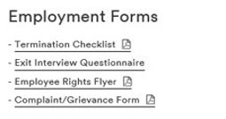
Found on Travis Central at the same link as the old PDF form:
Links directly to the online form (Works best in Chrome or Internet Explorer) :

Slide 38
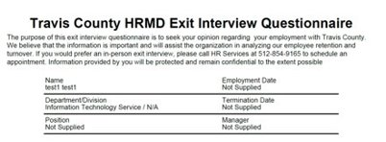
Once the survey is completed, the form is stored digitally in a secure OnBase system that HRMD can access:
Same format and questions as the original form

Slide 39
Recommended Process
When an employee submits their resignation or retirement notice, provide them with the opportunity to do an Exit Interview with the department and/or the Link to the survey. This link is also listed on the Termination Checklist that you can send to the employee. OR
HRMD can send the Termination Checklist and link for you if notified of resignation.
HRMD can help monitor for completion and send reminders to the employee if a final form hasn’t come through.

Slide 40
Travis County HHS/City of Austin Summer Youth Employment Program
Community Services Division
100 N. IH 35, Ste. 3200 Austin, TX 78701
Phone: (512) 854-4109 Fax: (512) 854-4864

Slide 41
Program Description
The Summer Youth Employment Program is a joint venture of the City of Austin and Travis County that provides approximately 750 young people with the opportunity to earn valuable work experience while earning financial independence during the summer.

Slide 42
Benefits of Summer Youth Employment Programs
Youth obtain a greater understanding of financial management
Participants obtain real-world work experience
Improved interpersonal communication and soft skills
Career choice advice and educational guidance
Interaction with positive adult role models
Connections for future career opportunities

Slide 43
Criteria for Participation
Travis County resident
Youth between 14 and 18 years of age
Youth with disabilities up to 22 years of age
Attends school and has a school ID or report card
Youth has a valid Social Security card
Youth must complete job readiness training and orientation
The youth’s parent or guardian is required to attend the first day of job readiness training

Slide 44
SYEP Historic Participation from 2004-2019

Slide 45
2019 SYEP Age Distribution

Slide 46
2019 SYEP Ethnicity Distribution

Slide 47
2019 SYEP Gender Distribution

Slide 48
Long term goals for SYEP
Provide a rich employment experiences
Positive organized activities
Increasing participants’ income
Developing young people’s skills
Networking to improve their labor market prospects
Offering constructive activities to promote positive behavior

Slide 49
Contact information
SHIRLEY PEEPLES
OPERATIONS COORDINATOR
MARGIE COLTER
YOUTH WITH DISABILITIES COORDINATOR
Phone: (512) 854-4590
Email: workbasedlearning@traviscountytx.gov

Slide 50
Talent Services

Slide 51
WHY ARE WE UP HERE TODAY?
To promote fair and equitable hiring
To ensure the County can defend your hiring decisions if ever challenged
To help guide you through the complicated Neogov steps
To support your department in creating a consistent hiring process
Notes:
As your HR Analysts reach out to you to schedule time for our roadshows, we can help create your hiring process as well as give refresher course
Today were going to be talking about setting up steps in Insight so OHC is utilized correctly. We’re going to spend just a few minutes to set up the initial steps and your Recrutiers will reach out to you with additional assistance. It’s important to have these steps set up so that we are able to track applicants through the hiring process

Slide 52
Notes:
The full process seen here is a lot. Let’s simplify!

Slide 53
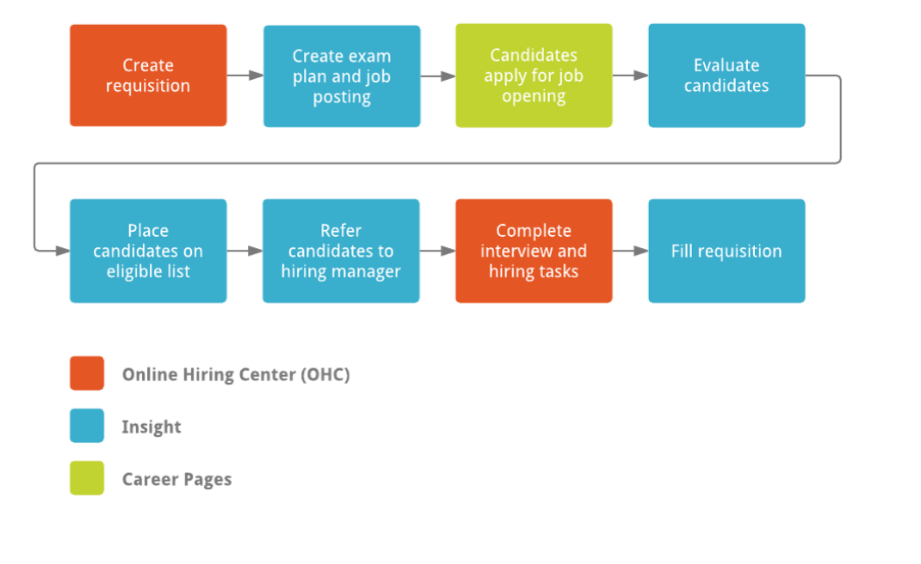
Insight access is limited to HR Liaisons, or people performing HR activities alongside the Liaison
OHC access is available to SMEs, Hiring Managers, HR Liaisons, Approvers, etc.
Notes:
The process can be pared down to these basics.

Slide 54
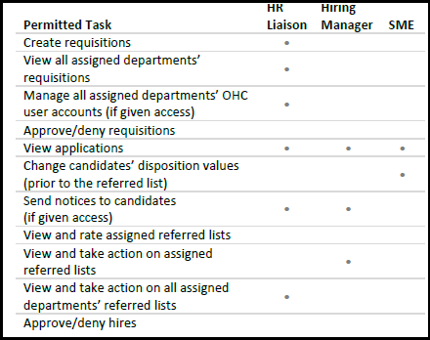
While Hiring Managers often have the SME role in Neogov, the SME role and Hiring Manager role are different. They have different views and different actions they can take. You can have one or the other or both.
The job of the SME review is to narrow down candidates in order to get the best pool to the Hiring Manager.
Notes:
There are many roles and permissions in Neogov. To ensure that HR and managers are able to use the process correctly and see candidates when they should it is important to ensure we have your roles set up correctly and to understand what each does and how it interacts with others

Slide 55
Process flow:
Application Received (Insight)
Minimum Qualification Reviewed (Insight)
Candidates are sent to SME for review in OHC (Insight)
SME review is done under “My Tasks” (OHC)
Phone Interviews/Panel Interviews can be completed at this time
Individual candidate or pool of candidates are put on an Eligible list and Referred to the Hiring Manager (Insight)
Hiring Manager can review Referred applicant(s) under “My Candidates” (OHC)
(Additional) Phone/Panel interview scheduled (OHC)
Offer made (OHC)
Background check initiated (OHC)
Offer accepted and Requisition Filled (OHC)
Requisition closed (Insight)
Notes:
This is a standard process flow for hire. Additional steps can be added. Additonal interviews, auto score, questionnaires, points, etc. SME reviews are an optional function so utilizing these other tools helps to narrow down a potentially large candidate pool

Slide 56
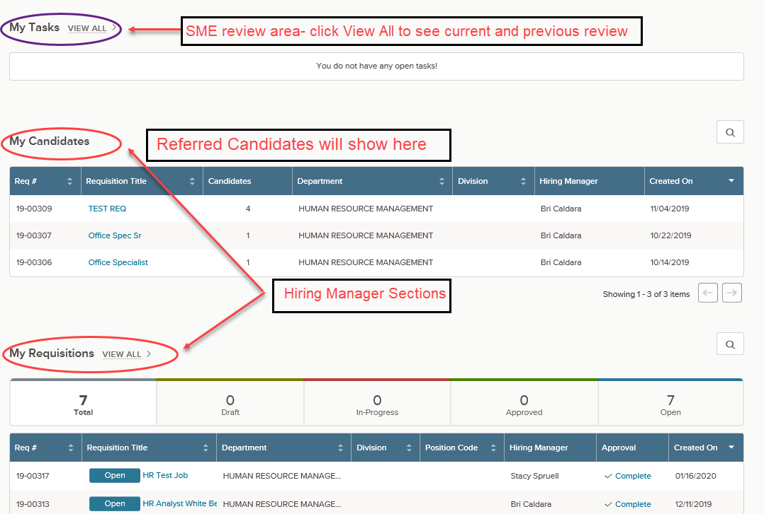
OHC
Notes:
This is what someone with SME and Hiring Manager view would see in OHC on their Dashboard. Everything in Insight and OHC can be started from here.

Slide 57
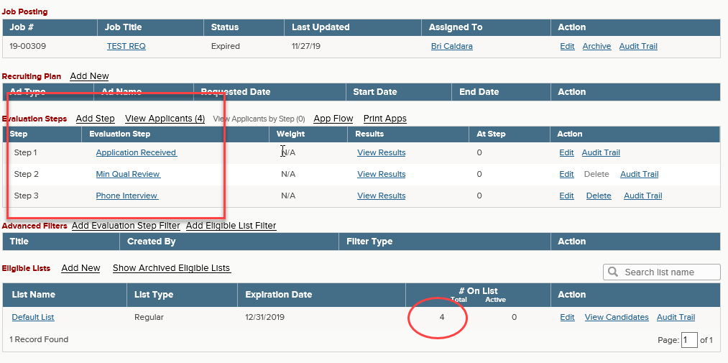
Exam Plan Step in Insight & Eligible List. All Candidates went through the steps and were Referred to the Hiring Manager in OHC
Notes:
The Exam plan is built in Insight before the Hiring Manager role ever sees the candidates. It is best to have it planned ahead of time, but steps can be added along the way

Slide 58
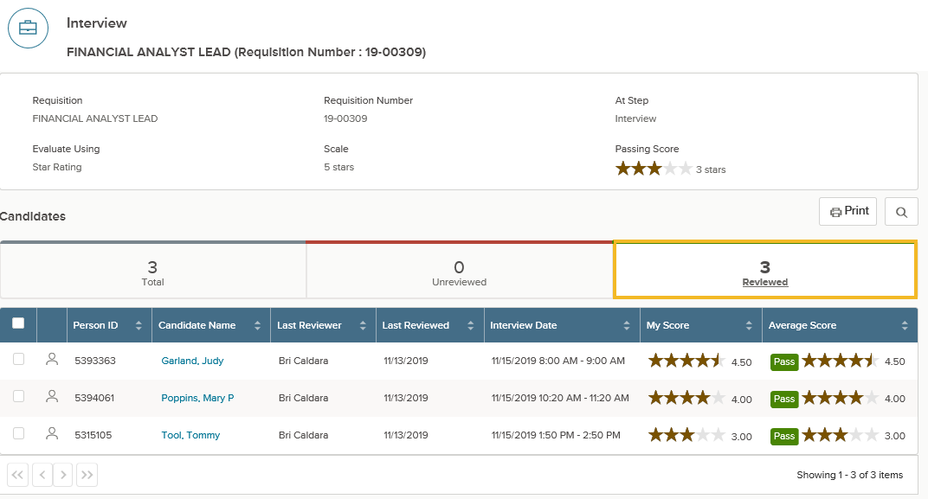
Completed SME Review step in OHC
Notes:
This is what an completed SME review would look like. The 3 candidates that were reviewed all received a Pass score and that is reflected back to the evaluation step in Insight

Slide 59
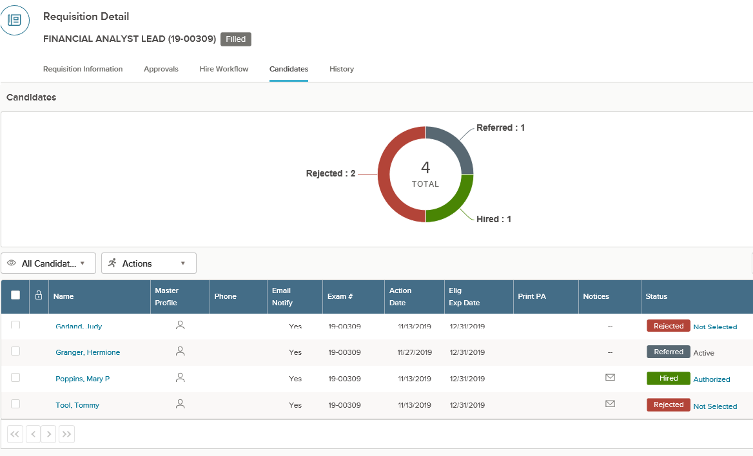
Hiring Manager View in OHC
Notes:
This is what a Hiring manager sees when viewing their candidates for a specific Requisition. This particular view is set to show all Referred candidates through the process, including the Hired candidate. The final step would be then to close the Requisition in Insight.

Slide 60
Director’s Report

Slide 61
Questions

Slide 62
DOOR PRIZES

