Slide 1
HR Liaison Meeting Human Resources Management Department Friday, July 26, 2019

Slide 2
Agenda
Director’s Update
Clinic Reminders
Compensation
HR Services
Talent Services
Benefits
Risk Reminders
Travis County
Human Resources Management Department

Slide 3
Director’s Update
HR SuccessFactors
Performance & Goals Beta Reviews
Performance & Goals Commissioner Court Roll-out
Update on FY19 Initiatives
Employee Engagement Survey Great Place To Work Certificates
Finalizing Benefits & Compensation for FY20
At-Will Just/Cause Policy review

Slide 4
Employee Health Clinic
Shawn Musarra
Travis County
Human Resources Management Department

Slide 5
Updates & Useful Information
Ms. Tanya Carter has joined the clinic team as of July 15th, she will be working at the Airport and Del Valle Clinics.
Interested in personalized health and nutrition strategies? Sign up to meet with our Health Coach, Mrs. Francis Diep. She has an office within the Main clinic and is mobile.
Stop by and see us!
Frances Diep, RD, LD, CDE
Health Coach, Onsite Health Strategies
UnitedHealthcare
O: 512-854-5860
frances.diep@traviscountytx.gov
Travis County
Human Resources Management Department

Slide 6
Clinic Locations, Days, & Hours of Operation
Mon-Thu 7:30 AM – 5:30 PM
Fridays 7:30 AM – 11:30 AM
Closed 12:00-1:00 PM for lunch
Main Clinic – (Open Monday-Friday) 700 Lavaca St., Suite 980
Airport Clinic – (Open Monday & Tuesday) 5501 Airport Blvd, Suite 201
Del Valle Clinic – (Open Wednesday- Friday) 3518 FM 973 South, Del Valle
For an appointment call: 512-854-5509
Don’t forget to bring your insurance card with you to each appointment for verification purposes.
Travis County
Human Resources Management Department

Slide 7
Compensation
Todd Osburn
Travis County
Human Resources Management Department

Slide 8
Compensation Topics
Compensation Status for FY 2020
Upcoming Compensation Items
Good-Bye Carlotta
Travis County
Human Resources Management Department

Slide 9
Compensation Status for FY 2020
Approved
Commissioners Court approved the MSS recommendations on 6/18 on a 5-0 vote.
Commissioners Court approved an increase to the Living Wage Rate (hereinafter called the County’s Minimum Wage) from $13 per hour to $15 per hour. Item passed 5-0 on 6/18.

Slide 10
Compensation Status for FY 2020
Under Consideration
Elected Official increases – some mandated by state legislature.
This item is expected to be discussed in Court on July 30th.
Step increase for POPS – funding in budget guidelines.
General Increase – great interest expressed by Court to do some type of general increase.
These items expected to be discussed in Court on August 6th.

Slide 11
Compensation Status for FY 2020
Additional Cost Drivers
Additional funding needed for retirement system.
Additional funding needed for shift differential.

Slide 12
Upcoming Compensation Items
Implementation of FY 2020 Changes
Changes to the Classified Pay Scale
Recommendations due to FLSA Threshold Change
Benchmark Study of FY 2020

Slide 13
Good-Bye Carlotta!
July 31st will be Carlotta Leavy’s official last day in the Compensation Division of HRMD. She is retiring after 22 years of service with Travis County.
Her last day in the office was July 22nd.
HRMD will be recruiting for her replacement very soon.

Slide 14
HR Services
Zephyr Stone
Travis County
Human Resources Management Department

Slide 15
HR Services
Interim Staffing
Department Point of Contacts
Update of HRS Initiatives

Slide 16
Talent Services
Travis County
Human Resources Management Department

Slide 17
NEOGOV Data Purge
Starts 10/1/19
Data from 9/1/10 to 9/30/16 will be purged
Data less than 3 years will be retained
Applies to all data associated with Exam Plans including job postings, applications, applicant notices, evaluation steps, test schedules, eligible lists, referred lists and associated hire workflow details, requisitions.
Applicant master profiles will not be purged.
Notes:
As announced in an email in May, our first NEOGOV data purge process will start on 10/1/19.

Slide 18
NEOGOV Data Purge
Lists of requisitions and exam plans will be sent to departments by August 2nd
Departments review and respond by August 30th
Let HRMD know what data needs to be kept
Involved or subject to pending litigation
Subject to EEOC claim
Open records request
IMPORTANT: Once deleted, data cannot be restored.
Notes:
What’s next? Prior to the purge…
*Depts will receive lists
*Depts needs to review and respond
-Take time to find out or identify what needs to be kept
-This might involve reaching out to others who might know if there is a litigation, claim, PIA request
Once data is deleted, it is gone forever. Even NEOGOV is not able to retrieve it.
More details will be in the email communication with the lists to be sent.
If you are not sure, please check with HRMD. We can meet with you if needed.

Slide 19
NEOGOV Talent Search
Talent Search is found in the Applicants menu.
Enter keywords, titles, or skills.
Notes:
Find potential candidates with Talent Search
Talent Search allows you to search for potential candidates within your own applicant pool using keywords, position titles, skills, and locations.
You will be able to search for applications that were submitted within 3 years of the current date.

Slide 20
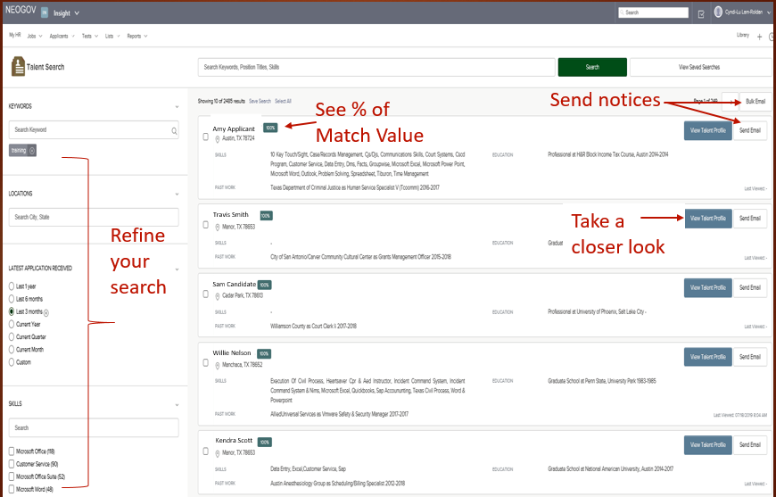
NEOGOV Talent Search
Notes:
In the left panel, you can refine your search areas such as Latest Application Received; Skills; Education; and Certificates/Licenses.
Has % of match for each applicant.
View Talent Profile will allow you to take a closer look at an applicant.
Email notices can be sent individually or in bulk from Talent Search.

Slide 21
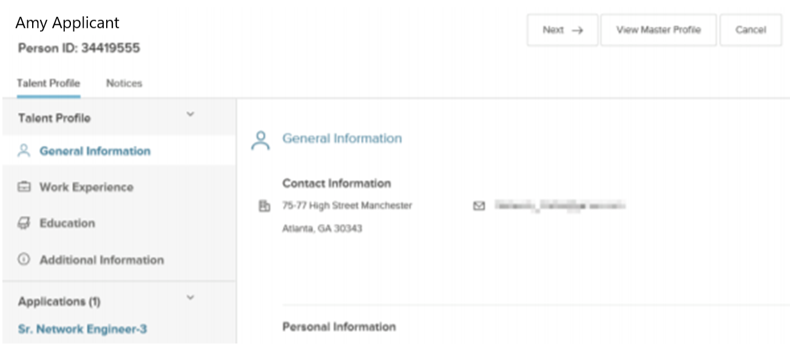
NEOGOV Talent Search
View Talent Profile
Notes:
The Talent Profile section has four areas: • General Information • Work Experience • Education • Additional Information
The Applications section will display to view applications submitted by the applicant. Only able to see applications submitted to your department.

Slide 22
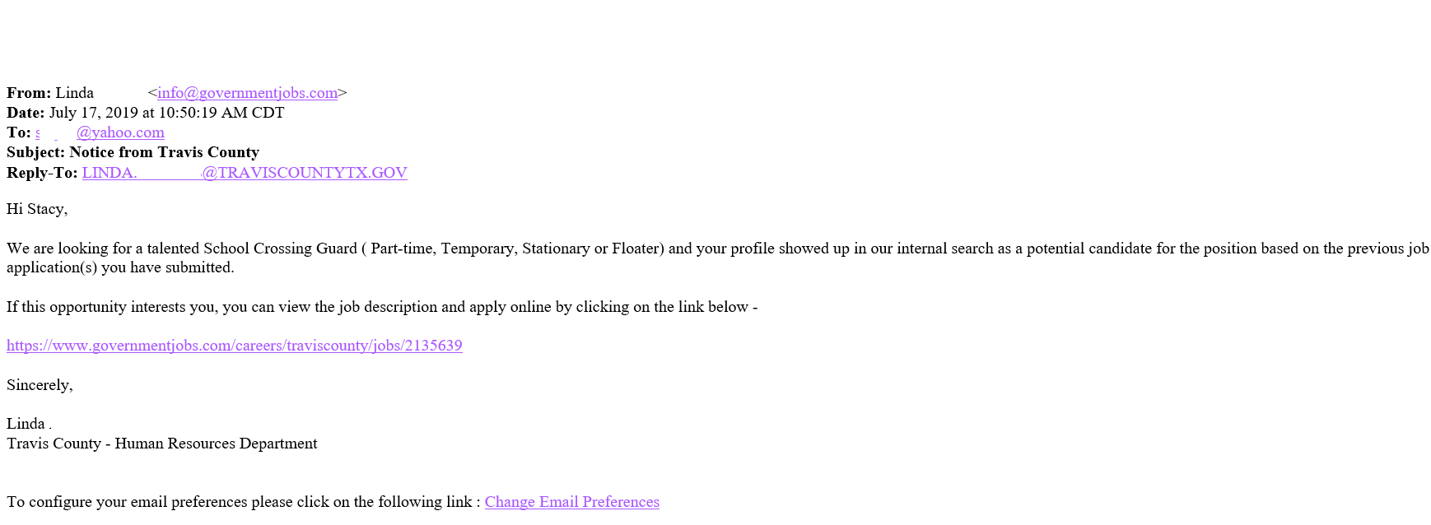
NEOGOV Talent Search
Example of Email Notice to Applicant
Notes:
Applicant will receive an email with a link to view the job description and apply for the job posting.

Slide 23
Benefits
Bridgett Kovar
Travis County
Human Resources Management Department

Slide 24
Benefit Changes for FY20
Commissioners Court approved health plan design changes and rate increases on June 25, 2019.
Health Plan Changes:
EPO and PPO – Virtual Visit Copay reduced to $10
Freeze enrollment for EPO – no new enrollments, but if currently on EPO allowed to make changes to dependent coverage.
HDHP changes will be effective January 1, 2020
Overall 2.1% rate increase to County, Employees, and Retirees
No changes to the Consumer Choice or HDHP.
Sun Life Dental rate increases to Base and High PPO plans.
No changes to Dental DHMO, Vision, Disability or Life Insurance.

Slide 25
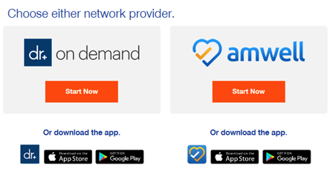
Virtual Visits
See and talk with a doctor 24/7 using a mobile device or computer
Most visits only take 10- 15 minutes
Doctor is able to provide a prescription if needed and will send electronically to the pharmacy of your choice
Most commonly used for Colds, Flu, Allergies, Fever, Pink eye, Sore throat. This service is not good for anything that requires a hands on exam or an emergency
Able to use for mental health visits as well

Slide 26
Nurseline
Registered nurses available 24/7 to answer health questions
Assists with decisions on seeking care
Will locate a provider, urgent care facility or hospital if needed
$0 copay for UHC members
Call the number on the back of your medical ID card

Slide 27
UHC Programs - available at no cost
Programs to help manage conditions such as Asthma, Coronary Artery Disease, Diabetes, Heart Failure
Spine & Joint Program
Cancer Support Program
Healthy Pregnancy Program
Kidney Resource Services
Congenital Heart Disease Program
Transplant Resources Services
Diabetes Support Program
Call the number on the back of your UHC ID card to see if you are eligible

Slide 28
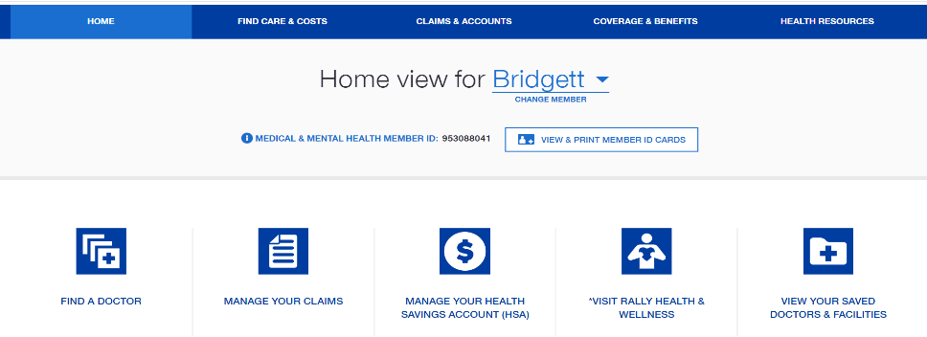
UHC Tools
MyUHC.com
View benefits
Estimate treatment costs
View claims
Find providers
View deductible status
Complete Rally Health Survey (offers challenges, missions and rewards
Health4Me Mobile App
If you’re traveling or simply away from home, the Health4Me app provides access to your medical benefits. Download the app for free.

Slide 29
Future Important Dates
Open Enrollment
August 1st- August 30th
Retirement Seminars
Date | Time | Location
Friday, September 20, 2019 | 9 am - 12 pm | 700 Lavaca Street, Multi- Function Room B
Wednesday, October 9, 2019 | 9 am - 12 pm | Gardner Betts Juvenile Center
Wednesday, October 9, 2019 | 1 pm - 4 pm | Gardner Betts Juvenile Center
Friday, November 8, 2019 | 9 am - 12 pm | 700 Lavaca Street, Multi-Function Room B
Friday, December 13, 2019 | 9 am - 12 pm | 700 Lavaca Street, Multi-Function Room B

Slide 30
Risk
James Alvarez
Travis County
Human Resources Management Department

Slide 31
Questions?

Slide 32
Next Meeting
October 18th
Travis County
Human Resources Management Department

