Slide 1
Employees: The First Line of Defense Against Cyber Threats
The evolving threat landscape and the role of AI

Slide 2
The Human Element in Cybersecurity
The most valuable asset in an organization.
Often targeted due to inherent trust and human nature.
The potential to be both the strongest and weakest link.

Slide 3
The Evolving Threat Landscape
Threats are not static; they evolve and adapt.
Increasingly sophisticated attack vectors.
The rise of AI-assisted attacks.
The past few years have seen a sharp rise in fraud resulting from cyber attacks.
Common Fraud Types:
Business Email Compromise (BEC): Deceptive emails convincing employees to make unauthorized transactions.
Account Takeover: Using stolen credentials to gain unauthorized access and commit fraud.
Fake Invoice Scams: Sending fake invoices to companies, leading them to pay for non-existent services or products.

Slide 4
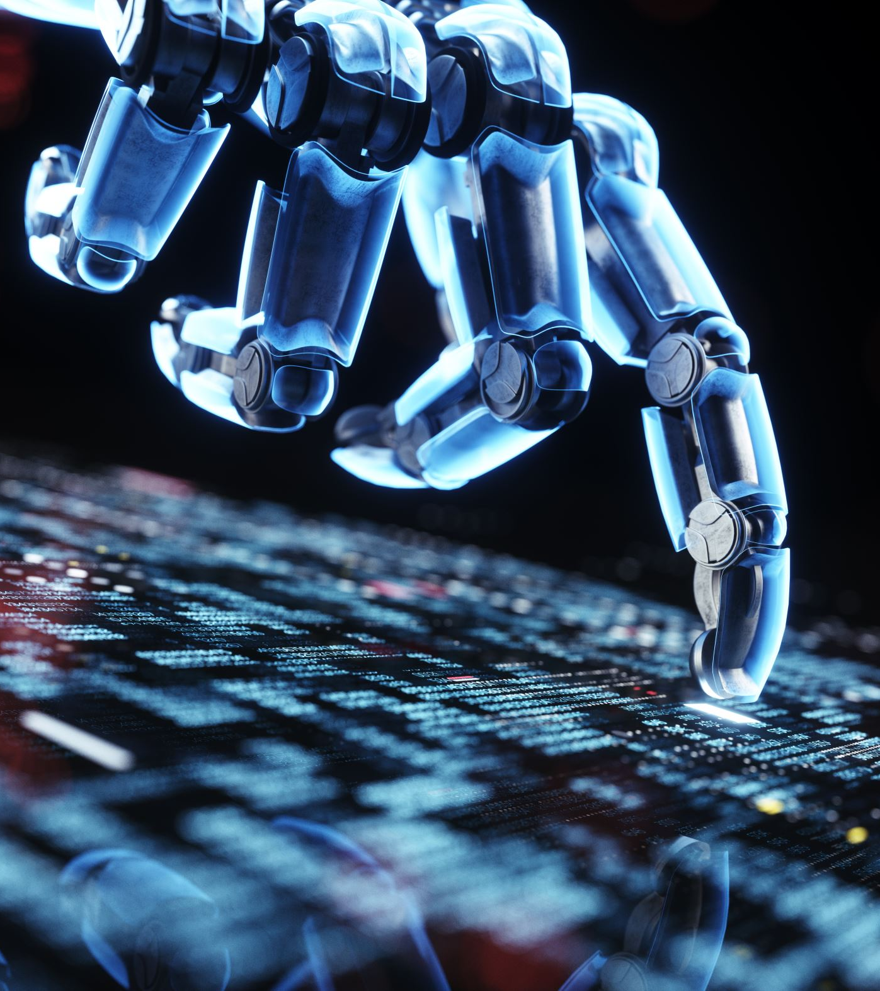
AI in the Hands of Attackers
Automated hacking tools using AI.
Rapid exploitation of vulnerabilities.
AI-driven phishing campaigns: harder to detect.

Slide 5
Why Employees are the Target
Hacking systems takes time and effort.
Access to critical company data and systems.
Human errors can bypass expensive tech defenses.
Social engineering: Manipulating people instead of hacking systems.

Slide 6
The Cost of Complacency
Data breaches can cripple an organization.
Loss of trust from customers and stakeholders.
Regulatory fines and legal repercussions.

Slide 7
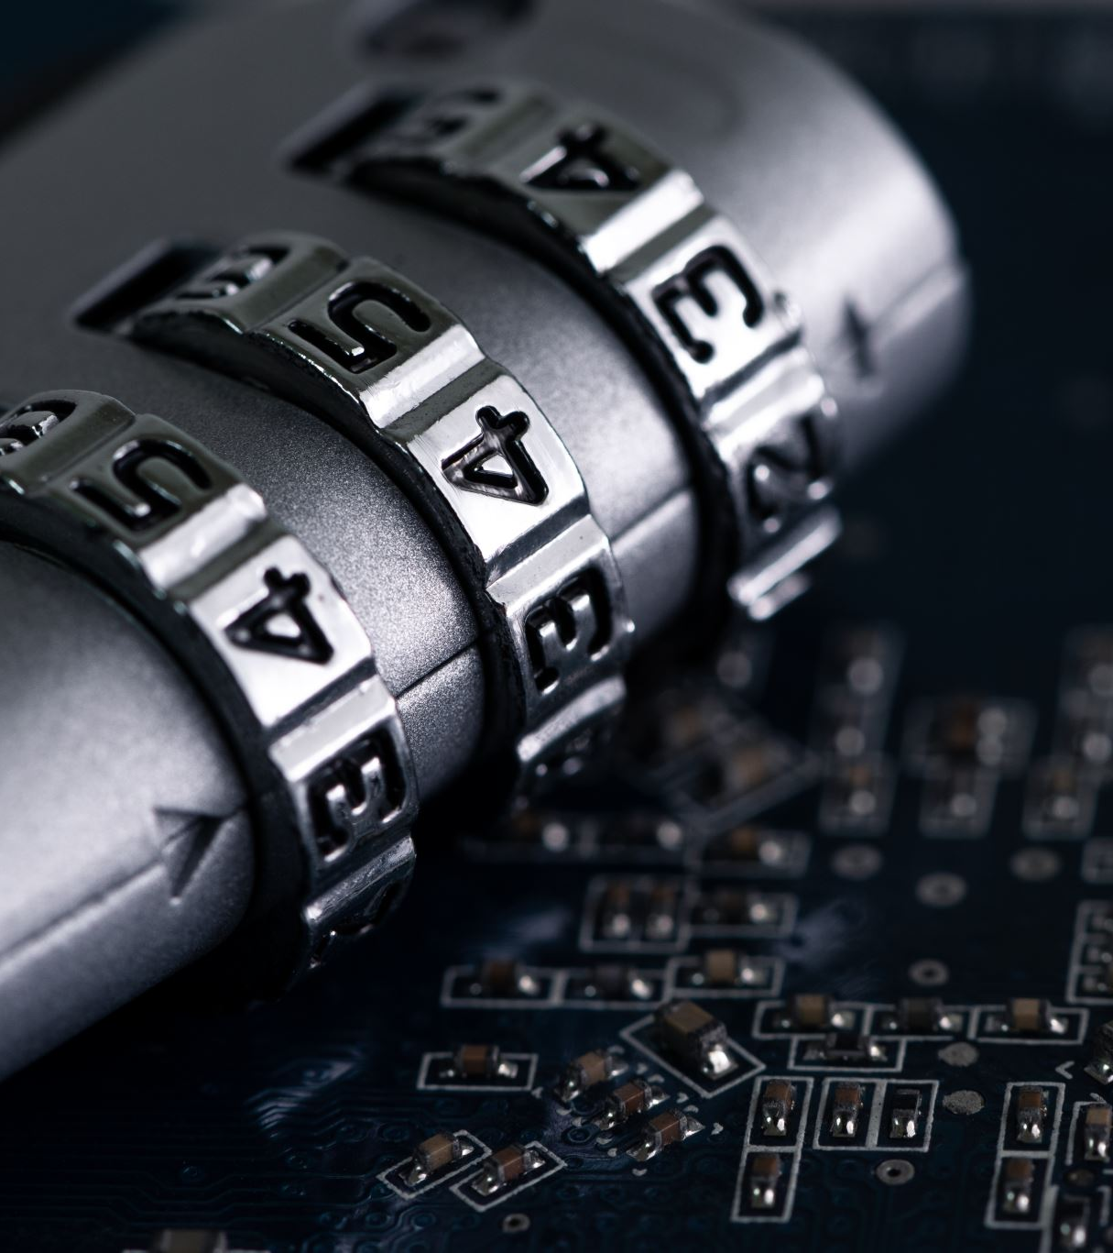
Security as a Habit, Not an Add-On
Incorporate security in daily workflows.
Regular updates and patches: A necessity, not a choice.
Always question unusual requests or communications.

Slide 8
Actionable Tips for Employees
Be skeptical of unexpected emails or messages.
Use strong, unique passwords and enable two-factor authentication.
Report suspicious activities immediately.

Slide 9
Conclusion
Every employee is a potential target, but also a potential defender.
Staying informed is the key to staying safe.
Together, we are stronger against threats.

