Slide 1
The Benefit of EAP
Zephyr Stone, TP&E​
HRMD U 02.29.2024

Slide 2
Mental Health and Wellness
Mental Health and Wellness at work is not just a catchphrase …
It’s a necessary discussion!
Notes:
We’ve all heard about importance of managing mental health and wellness in the workplace. While this has always been a discussion – the National Institute of Health had an article all the way back in 2010 that said: “Mental health problems have an impact on employers and businesses directly through increased absenteeism, negative impact on productivity and profits, as well as an increase in costs to deal with the issue. In addition, they impact employee morale adversely.”, the COVID pandemic has definitely brought discussions of mental health and wellness to the forefront, along with discussions about work-life balance, managing remote teams and living in this new post-COVID world.
It’s so important for all of us to have resources to help us manage the day to day and the things that just pop up. One of the resources Travis County has provided is Deer Oaks EAP.

Slide 3
Deer Oaks EAP
Notes:
Deer Oaks Employee Assistance Program (EAP) offers a lot of services for life and work. There is a link to the EAP on the Travis Central homepage.

Slide 4
Deer Oaks EAP
Contact EAP toll-free at (866) 327-2400 or visit their website at www.deeroakseap.com
Member login
and
Password:
traviscountytx
Notes:
You can call or go to the website for assistance.

Slide 5
Employee Benefits
Online Seminars / Training
Financial/Legal Assistance
Variety of topics from Work/Life Balance, Parenting, Stress, Caregiving, Healthy Living…
Articles and referrals for assistance… Even help with making a will and identity theft.
Safe Ride Home
Counseling
Reimbursement for ride-sharing in the event of an emergency.
Face –to-Face and phone counseling, including crisis counseling.
Notes:
The EAP has a variety of benefits – let’s mention a few here. All services are available for review on the Deer Oaks website. If you want to call to set up a time with a counselor, you are able to call yourself to set up a confidential session. You do not need manager approval to reach out for personal reasons.
There are flyers on the different services available listed on Travis Central on the EAP page. Again, there’s a quick link to the EAP on the Travis Central homepage.
HRMD is actually using 3 EAP leadership and stress mgmt. courses for a HRMD Leadership Certificate Program. The first course has already passed, but you can still watch the recording and get credit for the class. Going forward, there are 11 more classes – 3 EAP courses with 4 sessions each. Once you complete all 12, you can get a certificate from HRMD! I’ll post the link in the chat
You can also register for this program in the LMS by searching : “HRMD - EAP Online Leadership Series”.

Slide 6
Resources!
EAP specialists can help you locate providers for a variety of community resourses like financial planners, childcare and even pet sitting!

Slide 7
The Best Part!!! Deer Oaks provides EAP Services for all full-time/part-time employees, dependents, and anyone that lives in the household.
Notes:
Mental health and wellness aren’t solo activities – and they don’t just affect employees so EAP services are available to you and your dependents and household.
Family members can access the website and call for assistance at the same number to receive assistance.

Slide 8
Mandatory EAP Referral
Notes:
Another side of the EAP is the Mandatory EAP referral process.
Work performance and behavior issues are not always related to technical skills or process… sometimes an employee has something going on at home or needs some help looking at a situation from another perspective. The mandatory EAP process allows a department to require that the employee meet with an EAP counselor to look at the other things that may be affecting the employee’s ability to perform their duties.
Whether you are initiating or receiving the Mandatory referral, it’s good to know what the process is and how it works!

Slide 9
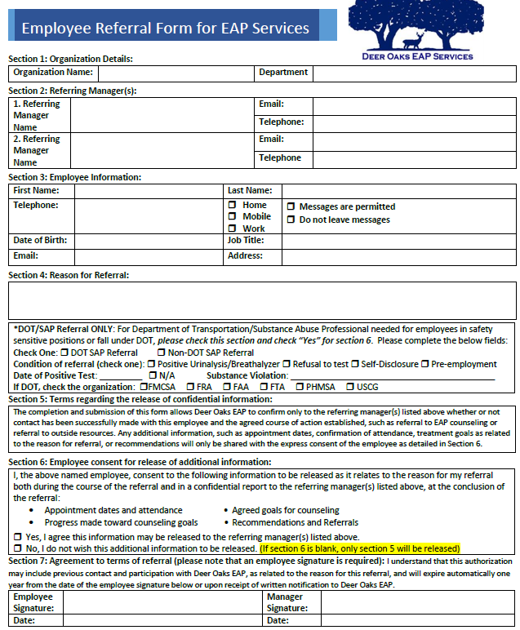
Process
Referral Paperwork
Consultation
Participation
EAP staff will reach out to the employee for an initial consult ation and plan creation.
EAP will make 3 Attempts
The employee will meet with their EAP counsellor to review the issue submitted by the department.
Sessions are confidential!
Department staff will meet with the employee to sign the referral form.
Notes:
To start the process – the employee and department will meet to discuss the reason for the Mandatory EAP. Usually, a mandatory EAP referral is assigned as part of a corrective action to help get an employee back to a productive state. This gives the employee an opportunity to address non-work related issues affecting their work. Employees should see this as the employer not giving up on them and trying every avenue to get things back on track.
I know I’m the HR lady saying this and, in the moment, it might be hard to hear that, but it’s important for all sides to look at this as an opportunity.
Since this is mandatory and part of a corrective process, the department will be checking the box on the form to allow the county to get updates on the referral and employee participation. “Section 6” The only people who will receive updates from Deer Oaks are the managers listed on the referral form. All EAP information is sent to Travis county via a secure messaging program requiring registration and log on.
Once the department has completed the referral form, it will go to HRMD for submission to Deer Oaks. HRMD checks to make sure the information is correct and goes to the appropriate contact at Deer Oaks.
After submission, an EAP intake specialist will reach out via the phone and email contacts listed on the referral form. They will make 3 attempts to contact the employee. After 3 unsuccessful attempts, the department will be notified of non-participation which can lead to additional disciplinary action.
However, if the employee responds the intake is completed with the employee and EAP counselor creating a session plan.
Travis County will receive confirmation of the intake, participation during the program and completion.

Slide 10
EAP Communication
Good morning,
We hope this e-mail finds you well today.
We’re writing you as to confirm that EMPLOYEE completed the telephonic intake with the EAP on DATE and was referred to EAP sessions. A Manager Referral Specialist will contact you again once we receive confirmation regarding their attendance of the first session.
Should you have any questions in the interim, please do not hesitate to reach out to us. Thank you.
Kind regards,
Notes:
We know that the idea of a mandatory referral makes employee’s nervous because they may discuss private and personal issues with the counselor. Travis County will never ask for, nor receive, anything personal nor private about the employee from the EAP. I’ve attached a sample initial consultation note from a previous EAP communication with names and dates removed…
And a session confirmation….

Slide 11
EAP Communication
Hi,
EMPLOYEE attended the 1st session with the EAP Counsellor and was engaged in addressing the reason for the referral. A Manager Referral Specialist will contact you following the 3rd session to provide you with an update.
Please do not hesitate to reach out to us should you have any questions prior to the Manager Referral Specialist contacting you.
Sincerely,
Notes:
And a session confirmation…. You will see that the note references “the reason for the referral” but does not list any specifics from the sessions.

Slide 12
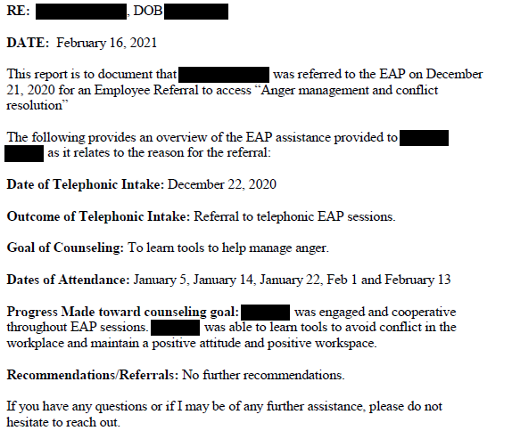
EAP Communication
Notes:
And conclusion….
As you can see – your employee (or you) can share childhood stories or personal fears/frustrations freely with the counselor if that’s what is needed to get to the bottom of an issue without fear that your info is going to be shared with the department.

Slide 13
Manager Consultation
If you are a manager dealing with a workplace situation that you are unsure about, the EAP also provides phone consultation for you too!
Helpline: (888) 993-7650
Email: eap@deeroaks.com
Web: www.deeroakseap.com
Notes:
The last services I’ll mention today is the Manager Consultation feature. Managing isn’t easy – so the EAP is here for you too! While managers can always count on HRMD and your leadership team for backup, you can reach out to the EAP for help with coaching, dealing with employee conflict, communication and talking through management issues as needed.
They’re an excellent option – and a neutral 3rd party – for you to keep in your pocket for when you need it.

Slide 14
References
NIH Article Slide 2: https://www.ncbi.nlm.nih.gov/pmc/articles/PMC3062016/
Rajgopal T. Mental well-being at the workplace. Indian J Occup Environ Med. 2010 Sep;14(3):63-5. doi: 10.4103/0019-5278.75691. PMID: 21461156; PMCID: PMC3062016.
Notes:
If you want to read the whole article…. I’ll put this link in the chat.

Slide 15
Thank you
Notes:
Thank you for attending today. This presentation will be saved to the LMS if you would like to share it with a coworker or employee to review.
I will be posting a link to a survey in the chat today. We value your feedback to the sessions and would love to hear what topics you may want to see or feel would be helpful to county staff.
https://forms.office.com/g/Zh8mUK3rHG

