Slide 1
FY 2025 Budget Guidelines
Planning & Budget Office
February 22, 2024

Slide 2
Presentation Overview
Economic Outlook & Federal COVID-19 Funds
Legislative Update
Budget Considerations
Five-Year Financial Forecast
Budget Preparation Guidance
Budget Calendar
Strategic Planning Effort & Performance Management

Slide 3
Economic Outlook
Economic Outlook & Federal COVID-19 Funds
The Austin Metro area continues to enjoy strong economic conditions; however, the area's higher cost of living could impact future growth
Unemployment rate one of lowest in nation at 2.8%
County received $247.5M in in ARPA-LFRF funds, all of which have been allocated. Track 2 funding includes Court prioritized projects and the Supportive Housing Initiative Pipeline (SHIP)

Slide 4
Legislative Update
88th Legislative Session Update
88th Legislative Session passed 1,139 bills and included various special sessions
House Bill 3474 establishes the Travis County Probate Court #2
House Bill 3697 streamlines requirements for the plat approval process
Senate Bill 2 includes a $100,000 homestead exemption for School Districts, reduction in school property tax rates, and three-year 20 percent appraisal cap on for commercial, mineral and residential properties that do not have a homestead and are valued at $5 million or less
Senate Bill 4 creates a new criminal offense for illegal entry into the US, carrying a maximum six-month sentence in county jail

Slide 5
Strategic Planning & Performance Management
Commissioners Court Strategic Planning Committee met throughout 2023 and reviewed the factor maps, strategies, and metrics related to the County’s seven strategic goals.
Staff will work to synthesize feedback gathered through these meetings and develop an implementation strategy, including timelines and priorities. Steps include:
Ranking strategic goals
Confirming program alignments to strategies and goals
Working with County teams of subject matter experts to crosswalk all the strategic goals and strategies with major County programs, initiatives, and plans

Slide 6
FY 2025 Updated Performance Management
FY 2025 Preliminary Budget departmental analysis and budget request recommendations will be published on the PBO website.
The FY 2025 Adopted Budget will include a new volume “Volume IV: Performance Management” for all departmental performance measures.
PBO will work with offices and departments on linking key performance measures to the Strategic Plan, once adopted.

Slide 7
FY 2025 Preliminary Budget Drivers
Items | Amount
Workforce Investments & Countywide Budget Drivers
Compensation & Benefits | $21.2M
Interlocal Agreements | 2.8M
Waller Creek TIF Agreement and BCP | 0.5M
Program Specific Budget Drivers
General Maintenance of Current Effort | 3.5M
Tech-related Maintenance of Current Effort | 2.9M
Justice Investments | 2.8M
Parks & New Facilities | 0.4M
Total | $34.1M

Slide 8
Five-Year Financial Forecast
Five-year financial forecast is prepared in consultation with Travis Central Appraisal District (property values) and County Auditor’s Office (revenue).
Historical County budget growth is not driven by a single issue or cost driver. Influencing factors include:
Population and related service demand increases
Workforce investments
New and expanded programs, improved service delivery, and state mandates
Local, state, and national economic conditions

Slide 9
Five-Year Financial Forecast County Property Tax Policy
County government is primarily funded through property taxes
The County’s approach toward property tax rate management recognizes that modest changes in the tax rate are an effective tool to respond to increasing cost of services
The No New Revenue Maintenance and Operations (M&O) Tax Rate, even with new construction values added to the tax base, does not always generate sufficient funding to keep pace with a growing population and rising costs
The County provides the maximum 20% Homestead Exemption and an additional $124,000 optional Homestead Exemption to those 65 and older/disabled
The FY 2025 Preliminary Budget will be balanced at the Voter Approval Rate
Future forecasting will use this property tax rate assumption

Slide 10
Homestead and Other Exemptions
Jurisdiction | Homestead Exemption | 65 and Older Exemption | Disability Homestead Exemption
Travis County | 20% | $124,000 | $124,000
 | with minimum of $5,000
Central Health | 20% | $124,000 | $124,000
 | with minimum of $5,000
City of Austin | 20% | $124,000 | $124,000
 | with minimum of $5,000
Austin ISD* | $100,000 | $35,000 | $25,000
Austin Community College* | 1% | $75,000 | $75,000
 | with minimum of $5,000
*These jurisdictions have a tax ceiling that sets the upper limit dollar amount for property taxes for these jurisdictions based on the first year of eligibility of properties with a 65 and older homestead exemption or disabled homestead exemption.

Slide 11
FY 2024 Overlapping Property Tax Rate
Total Taxes
$8,873
Austin ISD
$4,247
(47.86%)
Travis County
$1,448
(16.32%)
City of Austin
$2,119
(23.88%)
ACC
$580 (6.54%)
Central Health
$479 (5.40%)

Slide 12
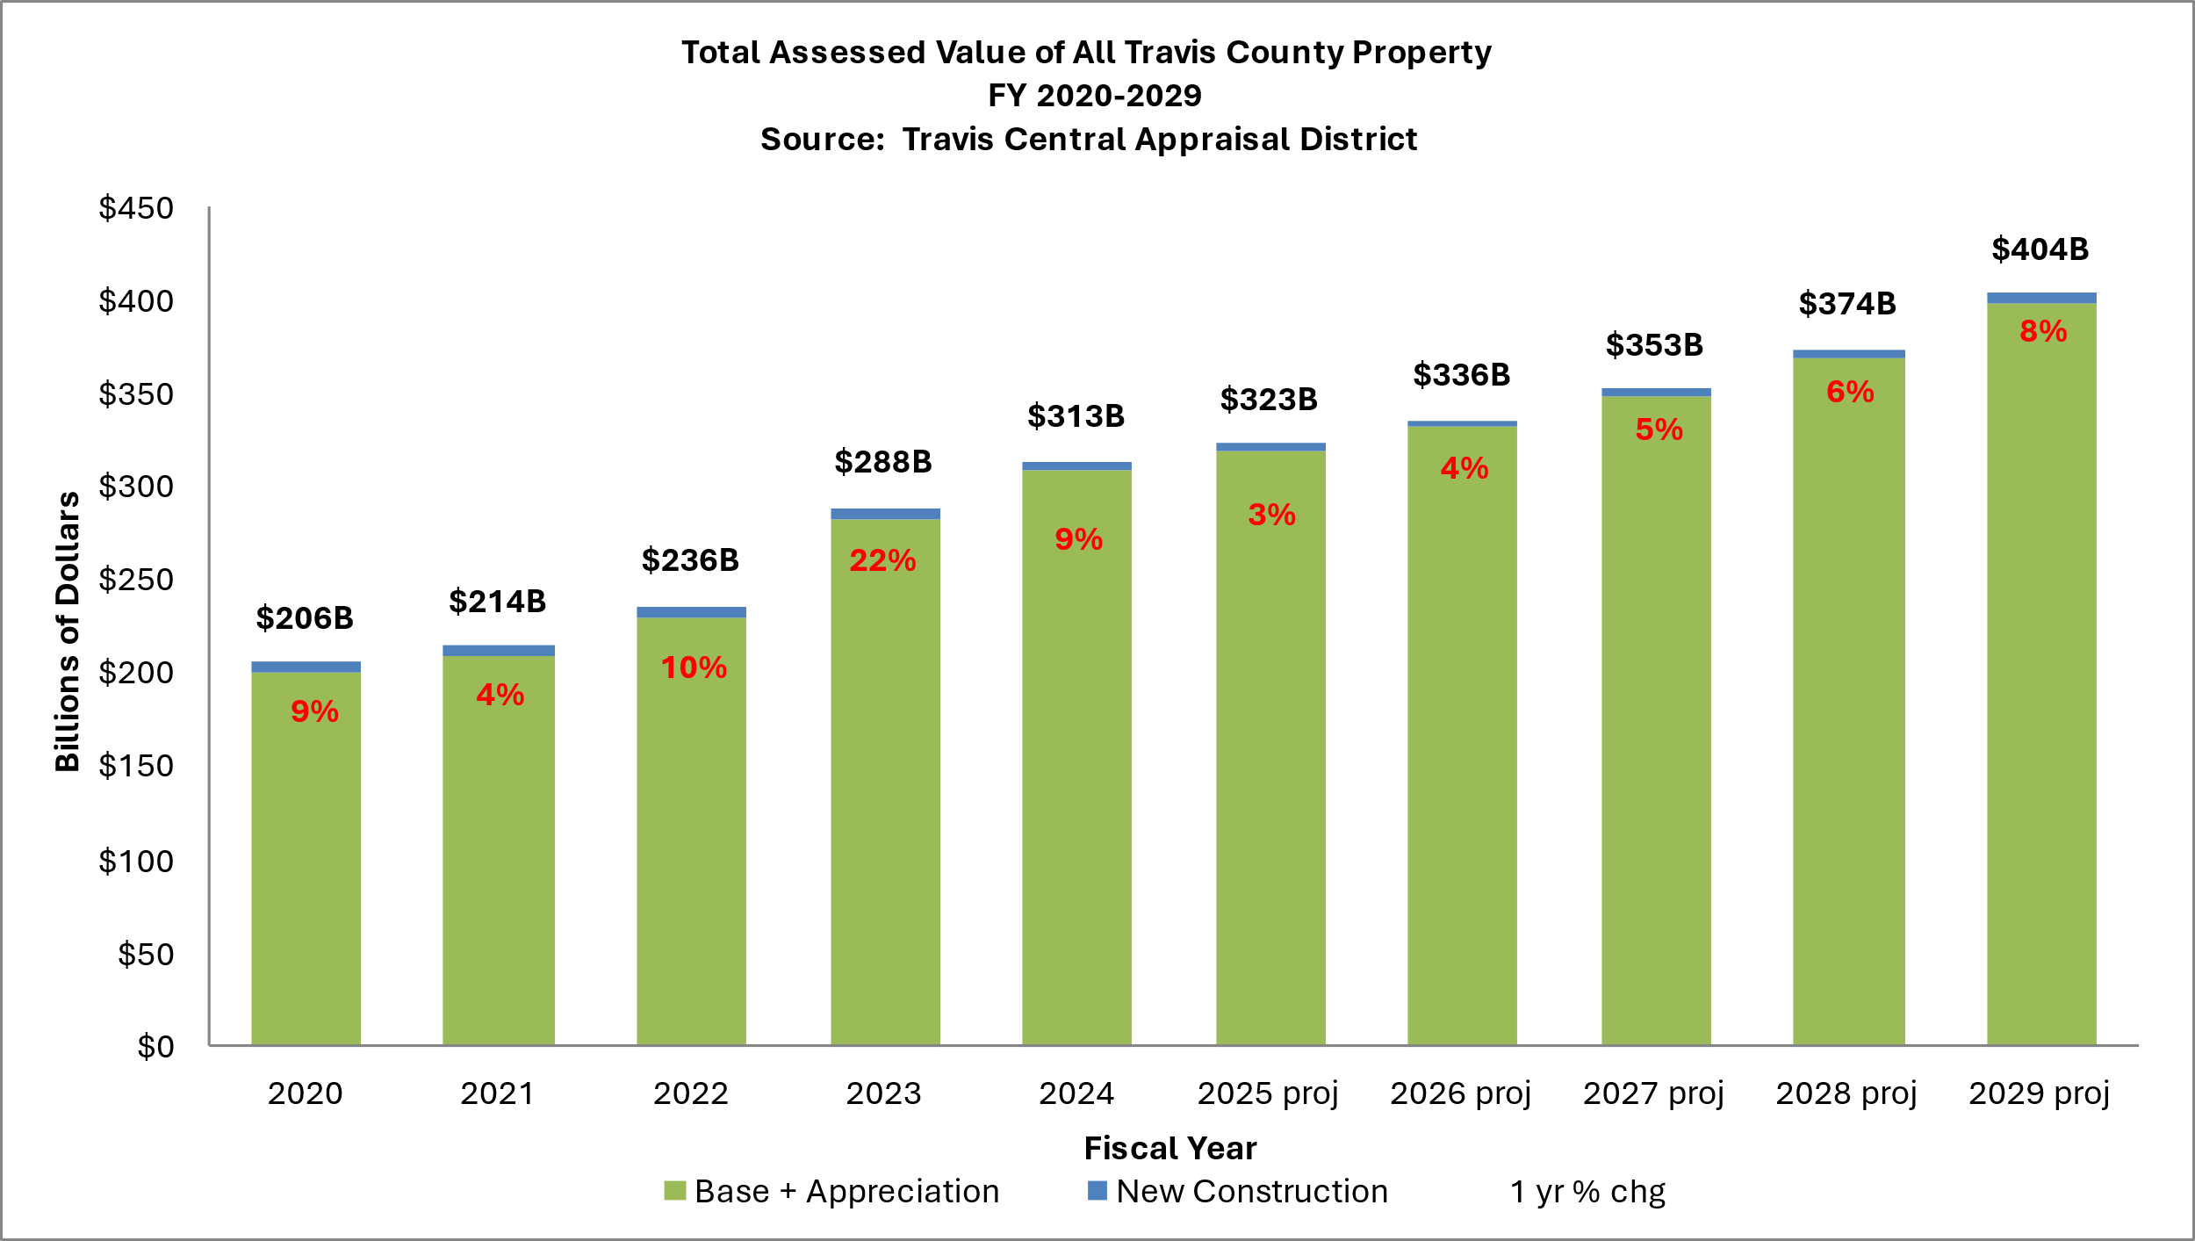

Slide 13
Travis County Tax Base Assumptions
Fiscal Year | New Construction Value | Net Taxable Value (NTV) | Total NTV Growth
FY 2024 Cert. Est. | $4.8 billion | $313.4 billion | 8.71%
FY 2025 Projected | $3.5 billion | $322.8 billion | 3.00%
FY 2026 Projected | $3.5 billion | $335.7 billion | 4.00%
FY 2027 Projected | $4.5 billion | $352.5 billion | 5.00%
FY 2028 Projected | $5.0 billion | $373.7 billion | 6.00%
FY 2029 Projected | $5.0 billion | $403.6 billion | 8.00%

Slide 14
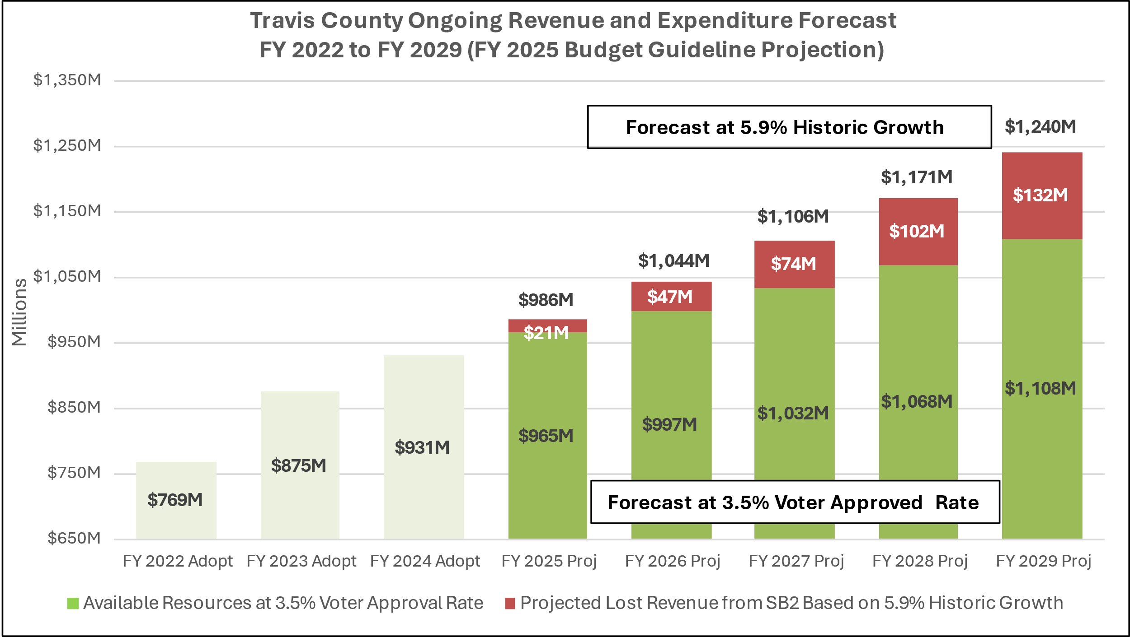

Slide 15
Budget Preparation Guidance
Look internally to maintain current service levels
Funding for new programs/FTEs greatly limited
Review of vacant positions >= 120 Days
Continue review of fees and revenue generating contracts for cost recovery (revenue generating contract increases limited to +15%, new contracts at full cost)
Continue to refine outcome measures with a focus on results and process improvement and incorporate needed changes from the Strategic Planning Process
Submissions should be developed within context of one-, three-, and five-year planning horizons
New ongoing revenue focuses on identified budget drivers

Slide 16
Budget Calendar Key Dates
Date | Event
March 4 and March 7 | Budget Kick-Off Meetings (8:30am – 12:20pm)
April 1 | Forms due to support departments (ITS, Radio forms, vehicles)
April 22 | Budgets Due to PBO by 5:00pm
April-June | PBO review of County Budget Submissions
June 4 | Employee Public Hearing (pending Commissioners Court approval)
June | Departmental Meetings with PBO
Week of July 29 | Preliminary Budget Published
August 12-16 | Potential Select Budget Hearings (If Requested by Commissioners Court)
September 5 and 6 (If needed) | Budget Mark-Up
September 17 | FY 2025 Tax Rate Adopted
September 24 | FY 2025 Budget Adopted

Slide 17
Budget Workbook
Workbook will now include:
Budget Submission Checklist
Proposed Position Changes List
Career Ladders, Internally Funded FTEs, Proposed Reclassifications, and Org Unit, Fund Center and Fund Changes
Grant Position, SPW, and 120-Day Vacancy Reports
Status Reports
Earmark Status Reports
CAR Status Report
Fee and Contract Review Sheets

Slide 18
Budget Workbook
Recommended Steps (in order):
Distribute any supporting sheets to relevant personnel in department
Review Position List for present accuracy
Data was pulled as of February 12, 2024
Make changes to Position List to align it as close as possible to how you anticipate the personnel looking on September 30, 2024
Includes: career ladders, expected promotions & retirements, add-pays, and expected salaries for new employees
Adjust operating budget as needed
Allocate any remaining Workbook balance down to $0

Slide 19
PB-1

Slide 20
PB-2
Organizational Summary Form
Addresses Organizational and Personnel changes
Organizational Structure
Internal Reallocations of Budget
Long-term Plans and Formal Studies
Proposed Position Changes
Detailed information on Proposed Position Changes List in workbooks
Additional support documentation (PAQs, Org Charts, etc.) must also be sent to HRMD

Slide 21
(Some) Other Forms
SBP is open
Measures mapped to new Countywide Goals
Forms have been copied to FY 2025
Work with PBO Analyst to address any changes needed for FY 2025
PB-4 and PB-5
Required for each budget request, unchanged from prior years
PB-6
One per department (if requesting capital items), unchanged from prior years
ITS Replacement Form
Due to ITS on April 1

Slide 22
Resources
PBO Intranet Page (https://traviscentral.traviscountytx.gov/pbo/budget)
Forms
Budget Manual
SAP HelpJuice
Planning and Budget Analysts

